Slide 1
Data Preparation Steps for FNN Based SOC Estimator LG 18650HG2 Battery Dataset
Prep by. Mina Naguib
PhD Student. McMaster Automotive Resource Center (MARC)
Jan 2020

Slide 2
Data preparation steps for FNN
Loading the whole dataset with different drive cycles for each temperature separated in one file.
Resampling each file to 1 Hz.
Concatenating Synchronously the dataset and plotting the Ah for each temperature.
Concatenating the whole data set (predictors {Voltage, Current, Temperature} and labels {SOC}).
Removing the errors in the dataset (Voltage, Current and Ah spikes).
Calculating the SOC by dividing the Ah data by the cell nominal capacity ( keeping the discharge start at 100% and the charge end at 100%).
Normalizing the predictors' dataset.
Adding the average from the normalized voltage and the normalized current according to predefined moving window width.
Chopping the normalized data into separate small files to fit the memory (optional step)
NOTE: The charge profiles used in the test datasets found in the “LG_HG2_Prepared_Dataset_McMasterUniversity_Jan_2020” have its initial part cropped to match the preceding SOC from discharge profile to remove data inconsistency regarding the xEV application.

Slide 3
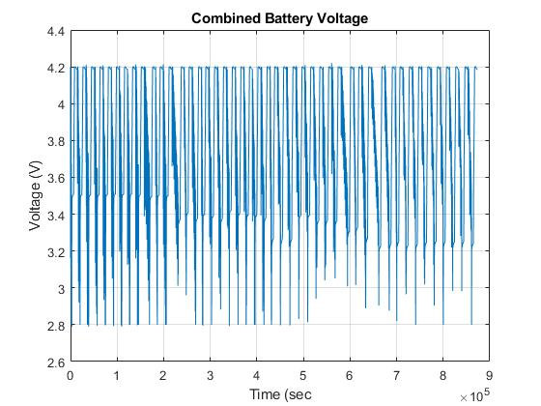
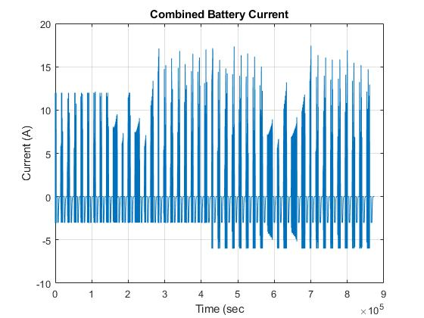
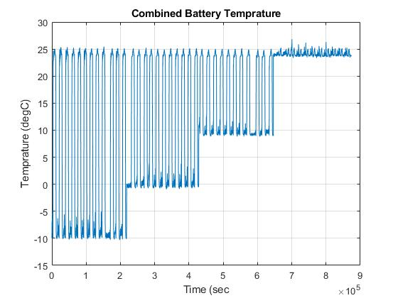
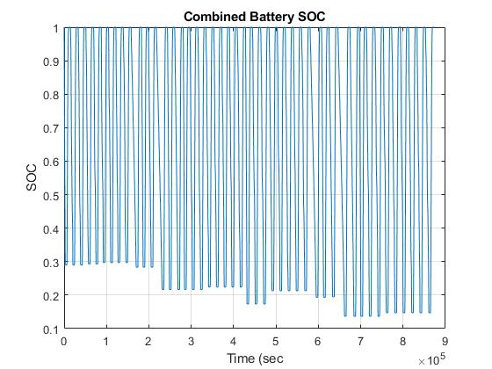
Dataset after concatenating all temperatures

Slide 4
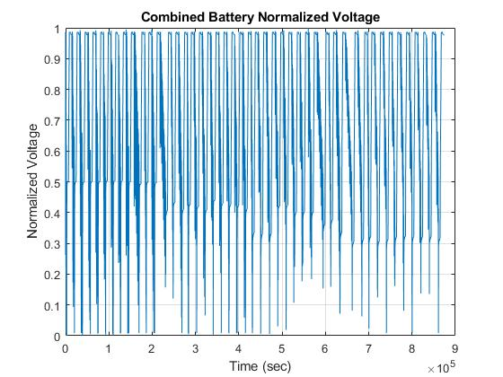
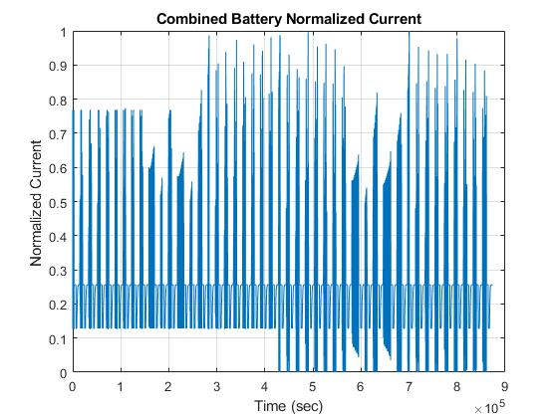
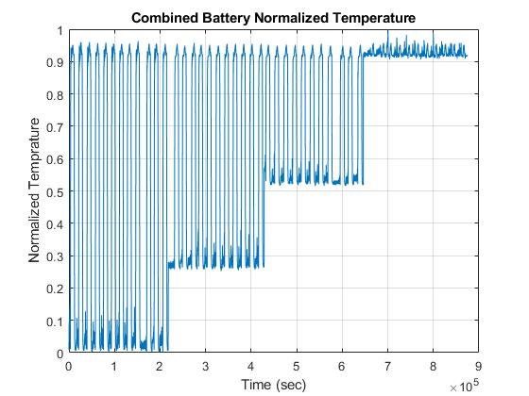
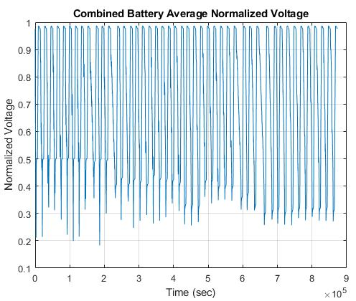
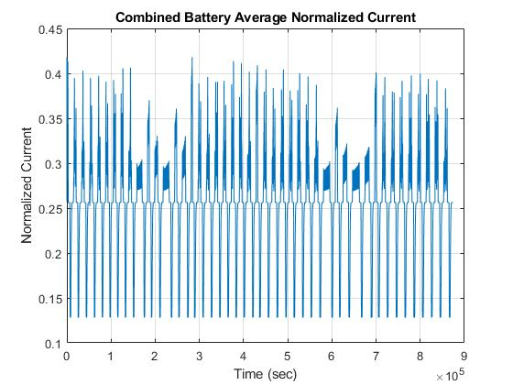
Normalized Dataset

